Slide 1
Clotho 3.0 Demo : MIT-Broad Foundry Integration
Prashant Vaidyanathan
CIDAR (Densmore Lab)
Boston University
<number>
Notes:
<number>

Slide 2
General Overview
Why Clotho?
Clotho Overview
High Level Overview
MongoDB
JSON
Demo
Storing Data
Querying Data
Running Functions and Scripts
Discussion
<number>

Slide 3
Why Clotho 3.0?
“It handles the really boring aspects of software development”
<number>

Slide 4
Why Clotho 3.0?
Biologists need to:
Store Data
Query Data
Run Scripts
Exchange Data
Learning and using existing database management systems can be a tedious task
Writing code can be a daunting task!
<number>

Slide 5









Abstract Overview
Databases
Spreadsheets,
CSV files
Clotho
Web Client
Widgets
Converters
Schemas
Scripts
Clotho-Aware Apps
<number>

Slide 6


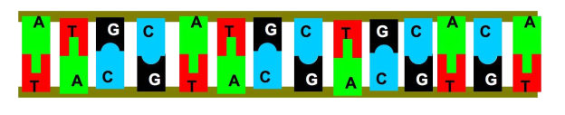






Specific Overview
CoSBi Database
GenBank File
Clotho
Web Client
Sequence
Viewer
Python Script
<number>

Slide 7


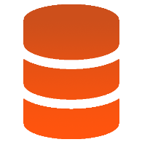
Practical Example
Data
Clotho Client
Client-side Dev
Clotho 3.0
API
Clotho Server-side
Converters
Schemas
Scripts
MongoDB
<number>
Notes:
<number>

Slide 8
MongoDB
Cross Platform Document-oriented database
Favors JSON-like documents with dynamic schemas
Makes integration of data in applications easier and faster
<number>

Slide 9
JSON
Open standard format that uses human readable text to transmit objects
Data objects consist of attribute-value pairs.
Eg : { “name”:”Prashant”, “age”:”24”, “university”:”Boston University”}
<number>

Slide 10
Demo
<number>

Slide 11
Storing Parts
Write Code to parse data into JSON format
Input
JSON Object (obj)
Clotho.create(obj)
JSON format
Reformat Data to make it easier to convert into JSON format
<number>

Slide 12
Minimal Code Required
var entiretext = document.getElementById('gateupload').value;
var lineArray = entiretext.split("\n");
for (var i = 0; i < lineArray.length; i++)
{
line = lineArray[i];
obj = JSON.parse(line);
Clotho.create(obj);
}
<number>

Slide 13
Querying Parts
1) Attribute to query (attribute)
2) Value of Attribute (value)
Clotho.query(attribute,value)
Result ->
JSON Object
<number>

Slide 14
Minimal Code Required
var queryVal = document.getElementById('nameSearch').value;
Clotho.queryOne("name",queryVal).then(function(data)
{
var name = data.name;
var id = data.id;
//data is the JSON object result
}
<number>

Slide 15
Running Functions and Scripts
1) Code
2) Arguments
Clotho.submit(script)
Result
Create Script
<number>

Slide 16
Minimal Code Required
var argumentVal = document.getElementById('funcArgument').value;
var codeVal = document.getElementById('funtionVal').value;
var script = "var data = {};\n"
+ "data.name = \"functionX\";\n"
+ "data.language = \"JAVASCRIPT\";\n"
+ "data.schema = \"org.clothocad.core.datums.Function\";\n"
+ "data.code = \"" + codeVal + "\";\n"
+ "data.arguments = [{name:'sequence', type:'String'}];\n"
+ "\n"
+ "functionX = clotho.create(data);\n"
+ "\n"
+ "clotho.run(functionX, [\"" + argumentVal + "\"]);";
Clotho.submit(script).then(function(data) {
//data is the result returned
}).done();
<number>

Slide 17
Other Clotho features
Login /User data management
User Profiles (integration with social networking services like Facebook)
Data Conversion
<number>

Slide 18
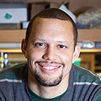
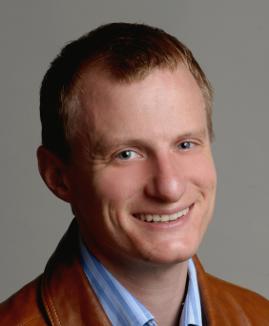
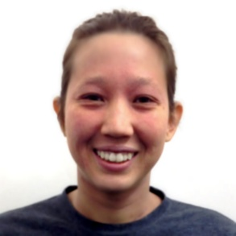








Clotho Team
Douglas
Densmore
J. Christopher
Anderson
Stephanie
Paige
Maxwell
Bates
Prashant
Vaidyanathan
<number>

Slide 19
Acknowledgements
Special Thanks to:
Tom Gorochowski – for all the data
Kevin Leshane – for his Clotho3API
Bryan Der – for his comments and feedback
Prof. Douglas Densmore
Stephanie Paige
Maxwell Bates
Prof Christopher Anderson
<number>

